Slide 1
Testing and Debugging Your iPhone Application
Notes:
1

Slide 2
Agenda
iPhone Facts
Developer Challenges
Enterprise Challenges
User Challenges
How Testing can help you?
Questions

Slide 3
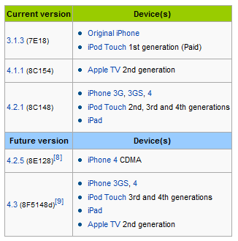
iPhone facts
As of EOY 2010 73.5 Million iPhones are sold
3 existing OS versions and Two on the way …

Slide 4
iPhone facts contd …
As of Jan 16 there are more than 400K apps available in app store. Download count down is reaching 10 Billion
More than $250 M revenue generated in Dec 2010 – of which 70% goes to developers
Around 75% apps are listed as paid (avg price $3.63)
Around 25% downloaded apps are paid (avg price paid including free - $0.91)
Around 10% of users have done “jailbreaking”

Slide 5
Challenges
Developer
Regression in multiple versions
Usability & Usage Pattern Analysis
Buffer Overflow
Enterprise
Data
Security
Shaping (from multiple sources)
Usage Pattern Analytics

Slide 6
Customer Challenges
Version Compatibility issues
Usability Issues
Data Unavailability / Security
Network hand-offs
Poor Performance

Slide 7
Security
Data Harvesting – MogoRoad, iSpy, Aurora Feint
Worms – ikee, Dutch Ransom, Privacy.A
Vulnerabilities – libtiff, SMS Fuzzing, Jailbreakme

Slide 8
Solutions …
Bring “Separation of Concern” in your Architecture and handle different concerns separately
Test your app on
Multiple iOS platform
Multiple Network (across globe)
Multiple iPHONE handset
Conduct effective Beta Test of your app and deliver more usable solution
Use Real Data and Real people to test Real Applications in Real networks
Analyze usage pattern of your app to identify areas of improvement (performance, security etc)

Slide 9
Tools
iPhoney - http://www.marketcircle.com/iphoney/
W3c - http://validator.w3.org
MobiReady - http://ready.mobi
FoneMonkey - http://www.gorillalogic.com

Slide 10
Thanks …
Notes:
10

